Slide 1
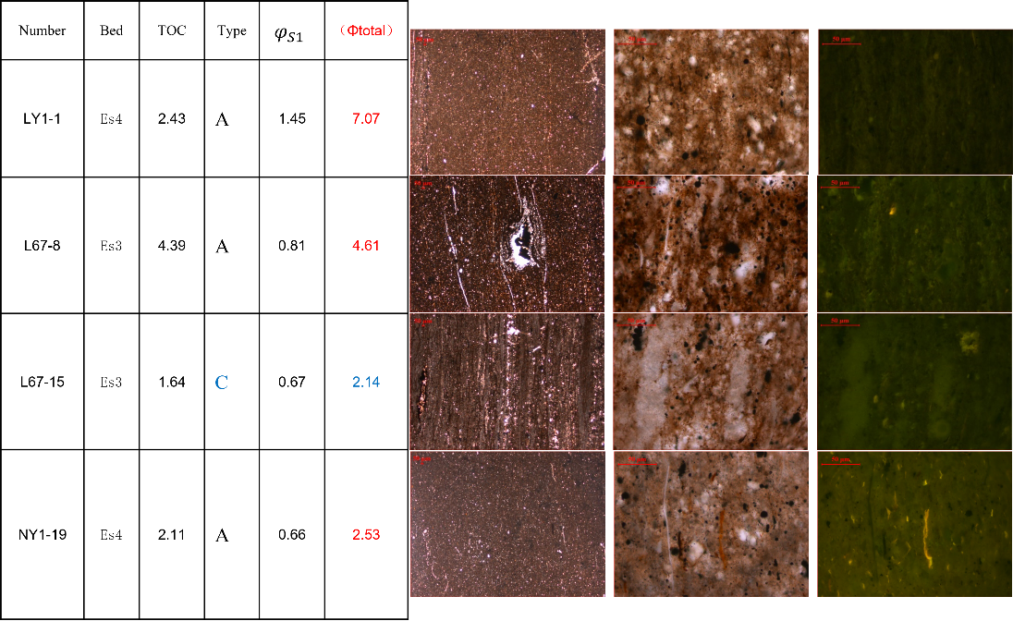
Poster fort the 1st International Biopetrological Congress (Shijiazhuang, Sept. 23-25, 2023)
Session 13: Black rocks and source rocks and evolution of Earth system and carbon cycle
Study on porosity of shale oil system with different petrographic characteristics and its
influencing factors
Can She ^{a,b}, Xiaomin Xie ^{a,b}, Kaixu Shi ^{a,b}, Jinping Tan ^{a,b}, Yumin Liu ^{a,b}
ª Hubei Key Laboratory of Petroleum Geochemistry and Environment, School of Resources and Environment, Yangtze University, Wuhan, Hubei 4301002, China;
^{b} Key Laboratory of Oil and Gas Resources and Exploration Technology, Ministry of Education, College of Resources and Environment, Yangtze University, Wuhan, 430100, China;
E-mail address: xiaominxie201911@sina.com (X.M. Xie)
Shale, as a major reservoir for shale oil and shale gas systems, has been the subject of many studies focusing on petrophysical analyses including porosity, permeability and pore size characteristics. These data are important for assessing shale resource potential, but the matrix pore structure of shale reservoirs is difficult to characterize because a large fraction of the total matrix porosity may be distributed in nanopores associated with organic matter and clay minerals.
In the Jiyang depression of the Bohai Bay Basin, shale oil is considered to be a very important resource. Against the background of the inadequacy and inaccuracy found in the past in evaluating shale oil from geochemical characteristics alone, the study of this topic can deepen the understanding of shale oil micro-components and physical parameters, and provide a theoretical basis for the evaluation of shale oil resources and oil and gas exploration. In this paper, shale oil samples of different lithologies were analyzed in terms of petrographic classification, total organic carbon, pyrolysis, and helium permeability determination.
By observing a large number of oil-bearing shale samples under transmitted light, reflected light, and fluorescence under an optical microscope, eight petrographic phases (A-H) were classified according to the criteria of lithology, the presence or absence of grain layer, the difference in hydrocarbon storage mode, and the mineralogical composition, etc.
Fig. 2: The result of Rock-Eval and the porosity measurement, combined with their own micro-petrographic phase
References
Ghanizadeh A, Amann-Hildenbrand A, Gasparik M, et al. Experimental study of fluid transport processes in the matrix system of the European organic-rich shales: II. Posidonia Shale (Lower Toarcian, northern Germany). International Journal of Coal Geology, 2014, 123: 20-33.

